Slide 1
EECS 498 System Design of a Search Engine
Winter 2026
Lecture 4: HTML, Utf8, HTTP and redirects
Nicole Hamilton
https://web.eecs.umich.edu/~nham/
nham@umich.edu

Slide 2
Agenda
Course details.
Unicode and Utf8.
HTML.
HTTP.
Redirects.

Slide 3
Agenda
Course details.
Unicode and Utf8.
HTML.
HTTP.
Redirects.

Slide 4
details
Need to finalize the groups right away.
Questions about homework, group photos?

Slide 5
Agenda
Course details.
Unicode and Utf8.
HTML.
HTTP.
Redirects.

Slide 6
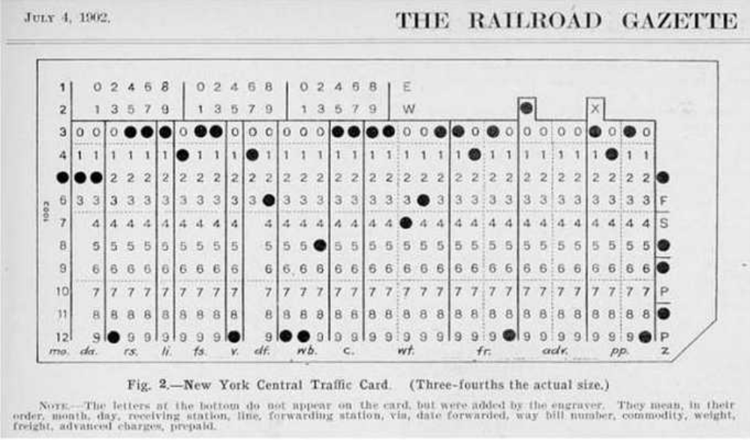
in the beginning
Punch cards.
Invented by Herman Hollerith in the 1890s for tabulating census data.
Introduced a columnar format and a 6-bit character code.

Slide 7
in the beginning
IBM was formed in 1911 in a merger of 3 companies, including Hollerith’s Tabulating Machine Company.

Slide 8
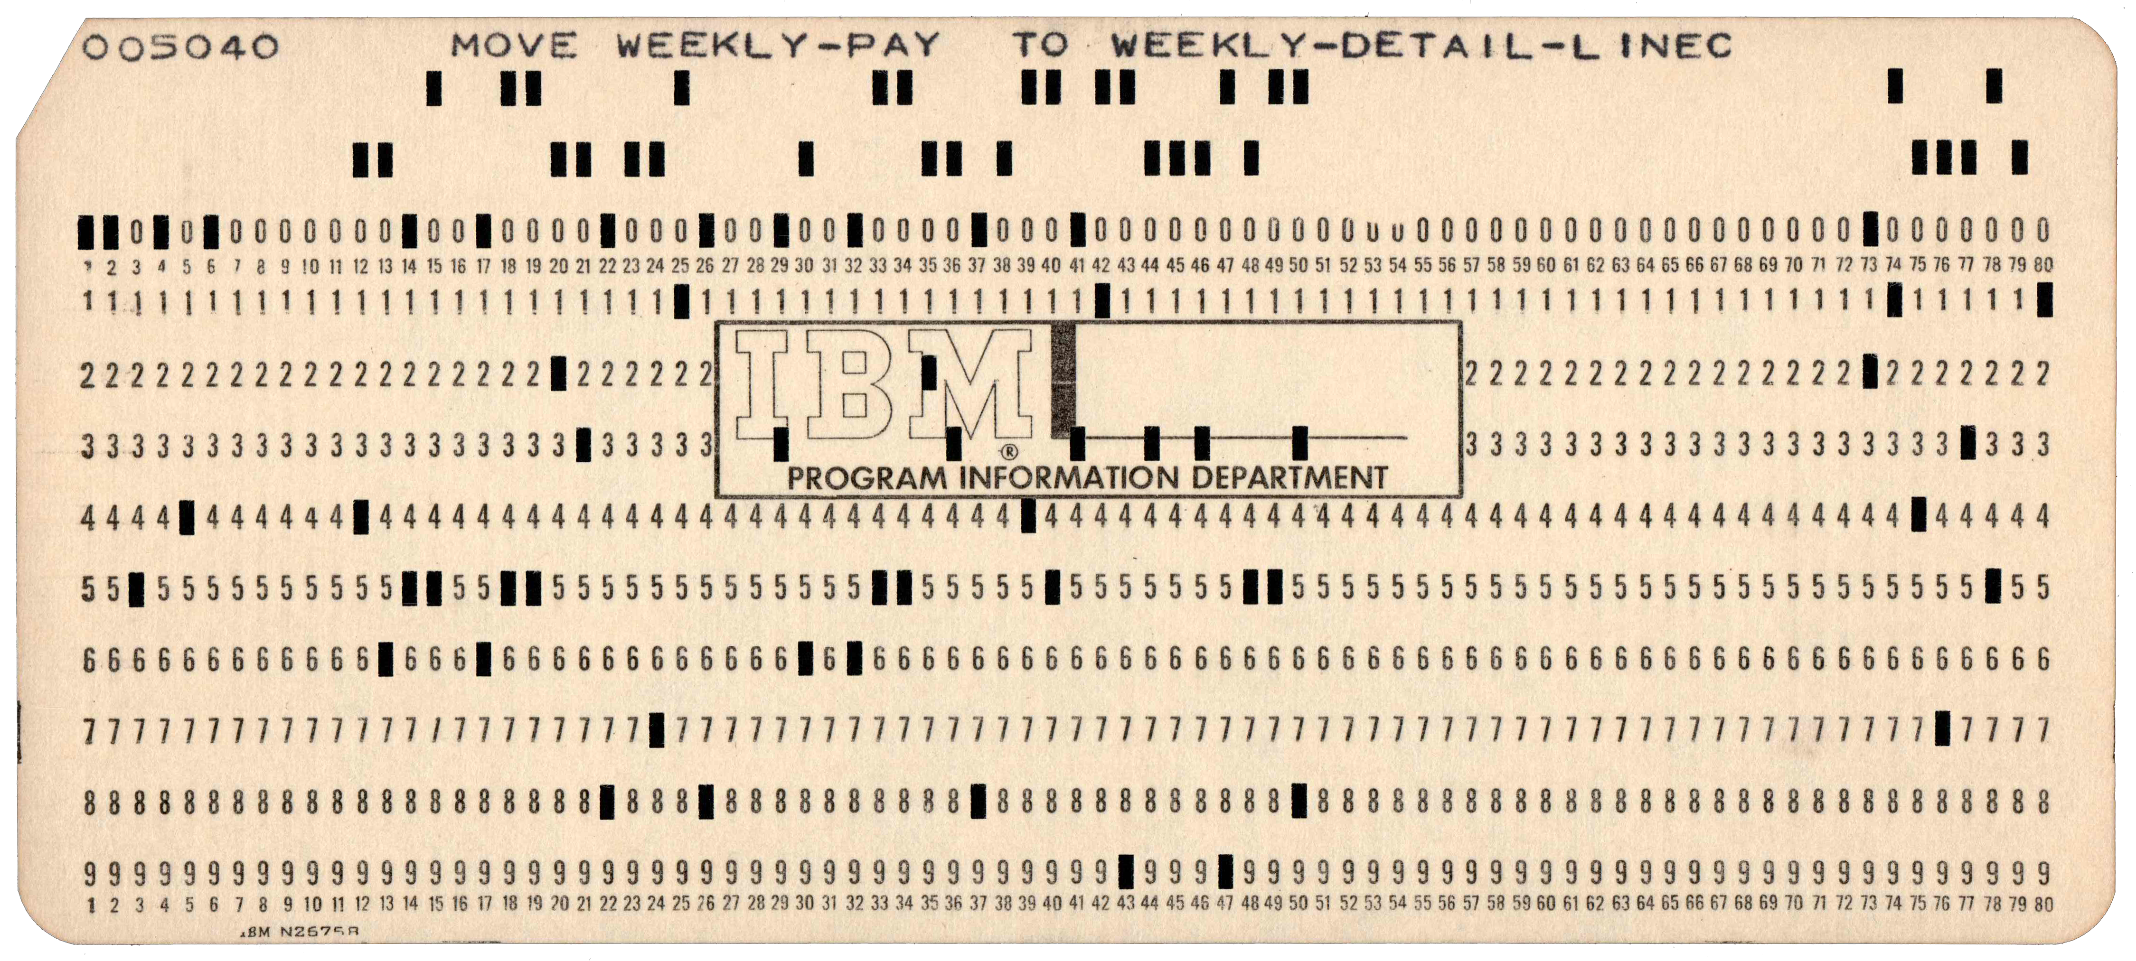
in the beginning
The IBM card became ubiquitous in the 1960s with its 80-column format.
The character encoding was based on the earlier 6-bit encoding.

Slide 9
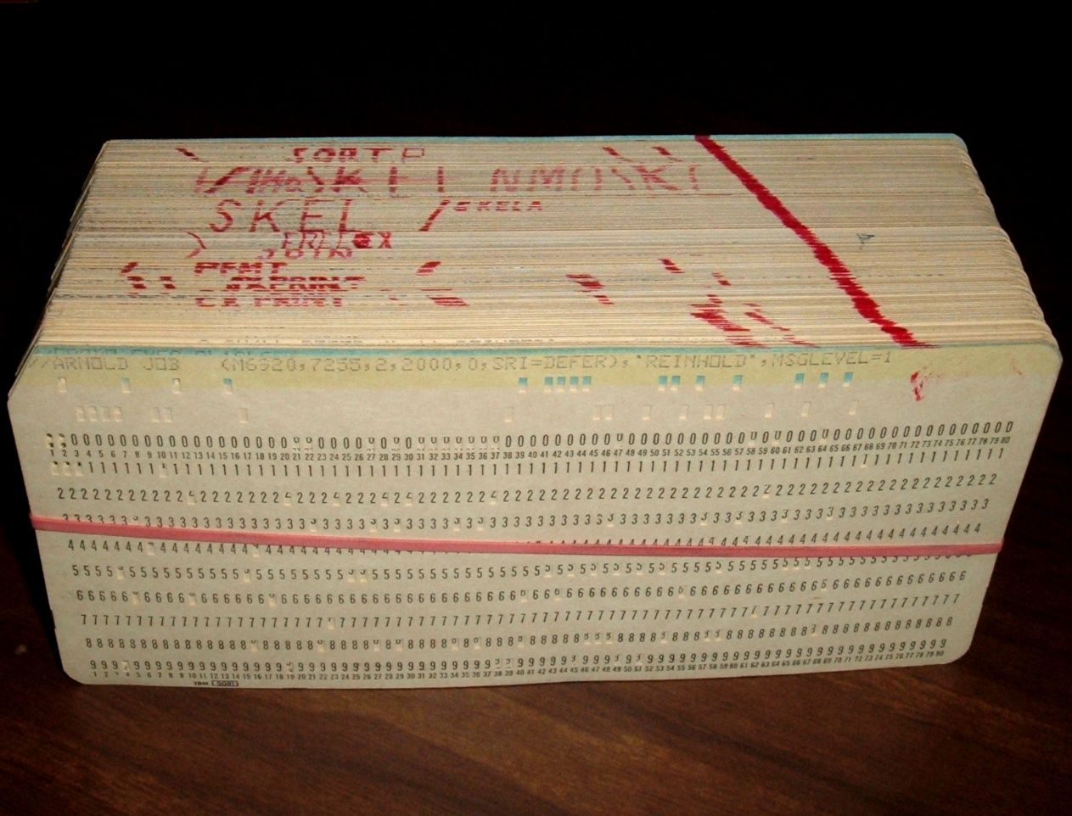
in the beginning
People walked around with decks of these cards holding their programs.
Imagine if you spilled one.

Slide 10
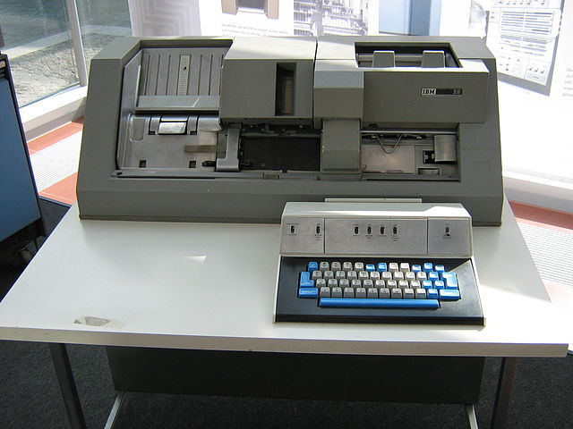
in the beginning
You used a keypunch to make them.
This is an IBM 029, released in 1964 as part of the System/360 rollout.
Businesses usually typed every card twice to verify they were correctly transcribed.

Slide 11
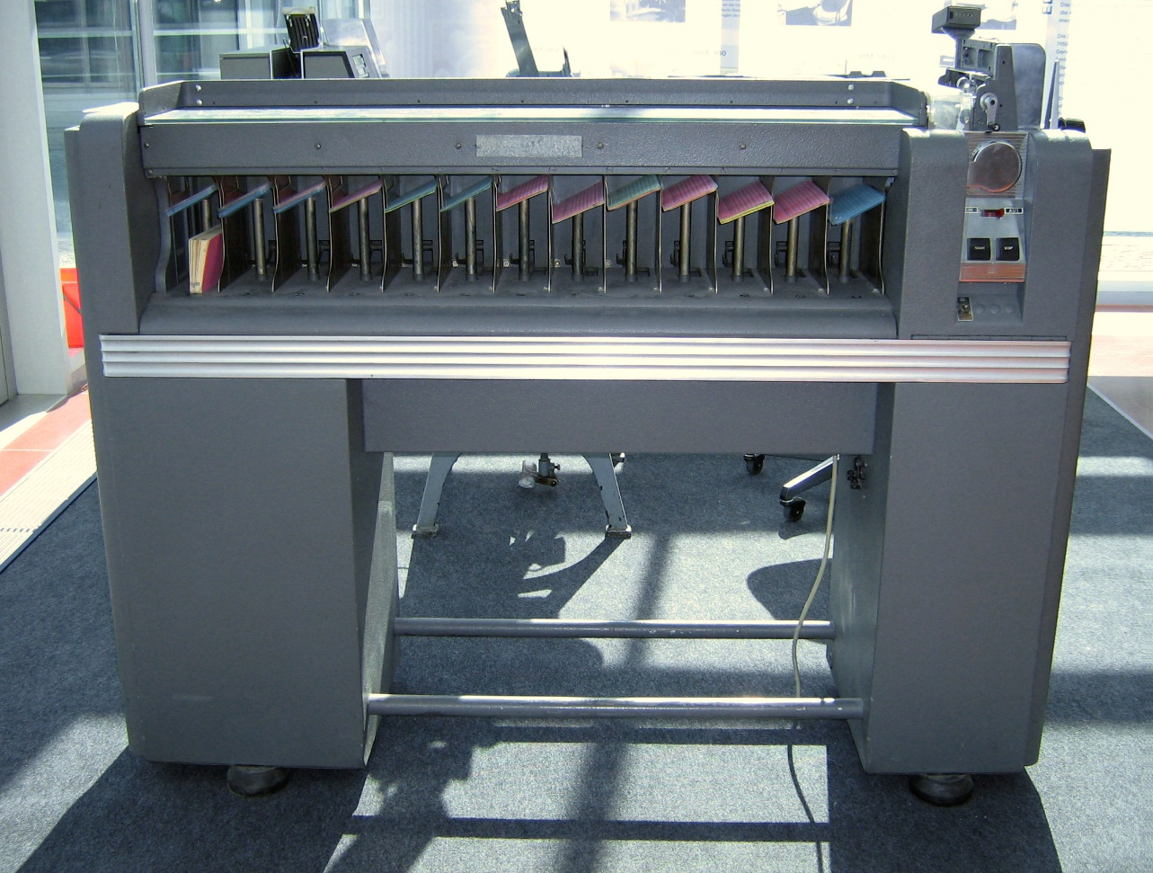
in the beginning
To sort data, you used a card sorter.
This is an IBM 082, introduced in 1949 but still in use into the 1960s.
Like all card sorters, it sorted one column at a time.

Slide 12
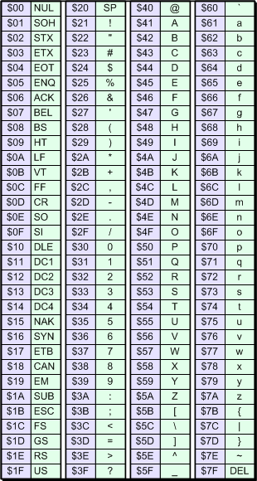
how do you represent text
In 1963, ASCII (American Standard Code for Information Interchange) was finalized as a 7-bit standard.

Slide 13
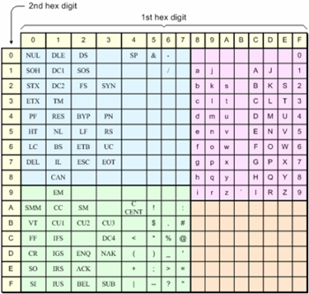
how do you represent text
As part System/360, IBM developed and introduced their own 8-bit EBCDIC (Extended Binary Coded Decimal Interchange Code)in 1964 derived from their punch card machines.
Notice the breaks in the character codes between I and J and R and S.
ASCII won.

Slide 14
how do you represent text
But 7 bits is not enough to represent all the characters in languages other than English.

Slide 15
how do you represent text
The solution was to introduce the notion of code pages, 8-bit codes where the high half, 0x80 to 0xff depended on what country you were in.

Slide 16
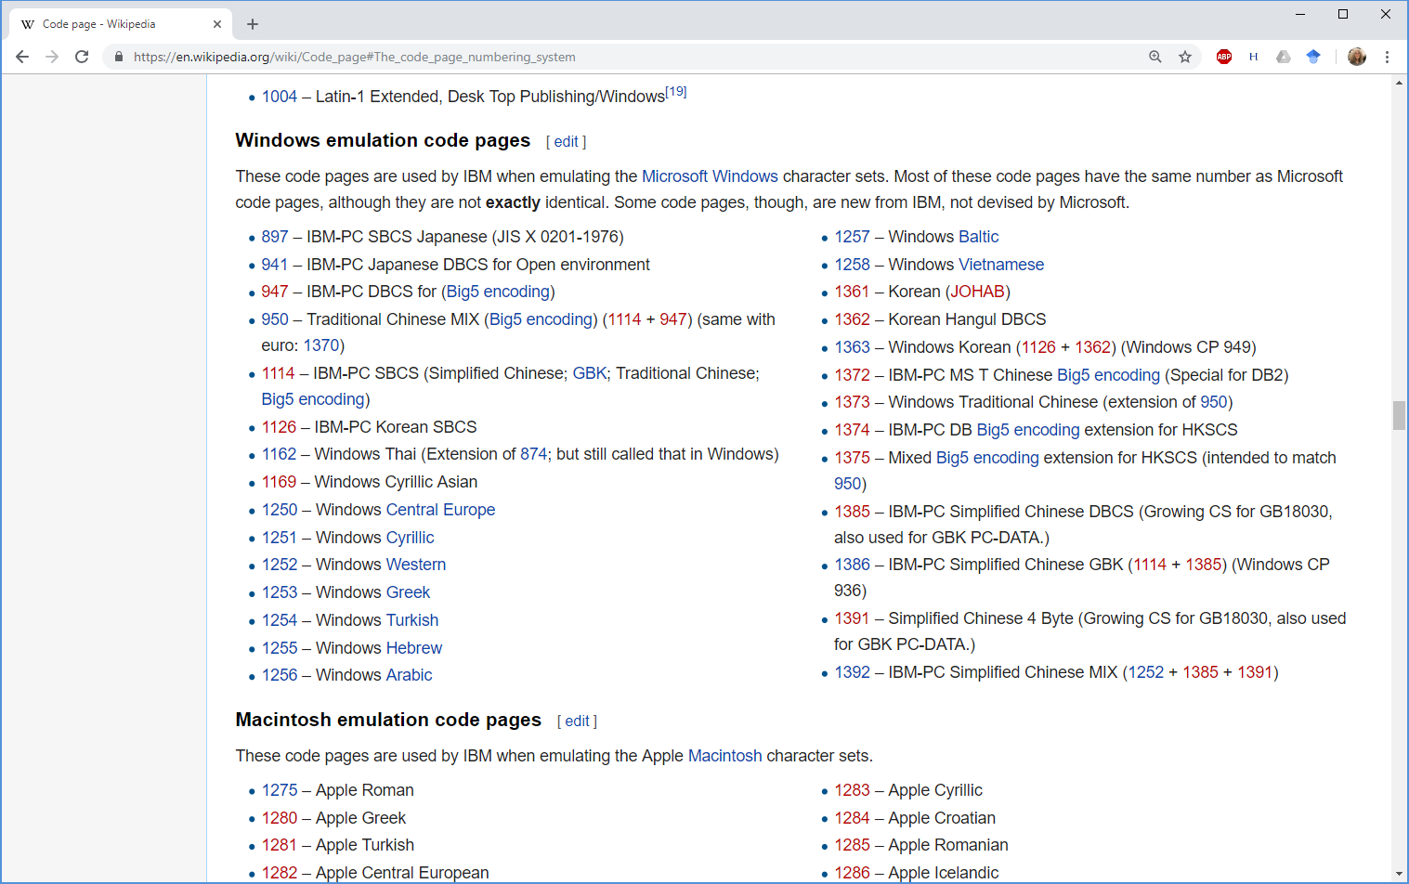

Slide 17
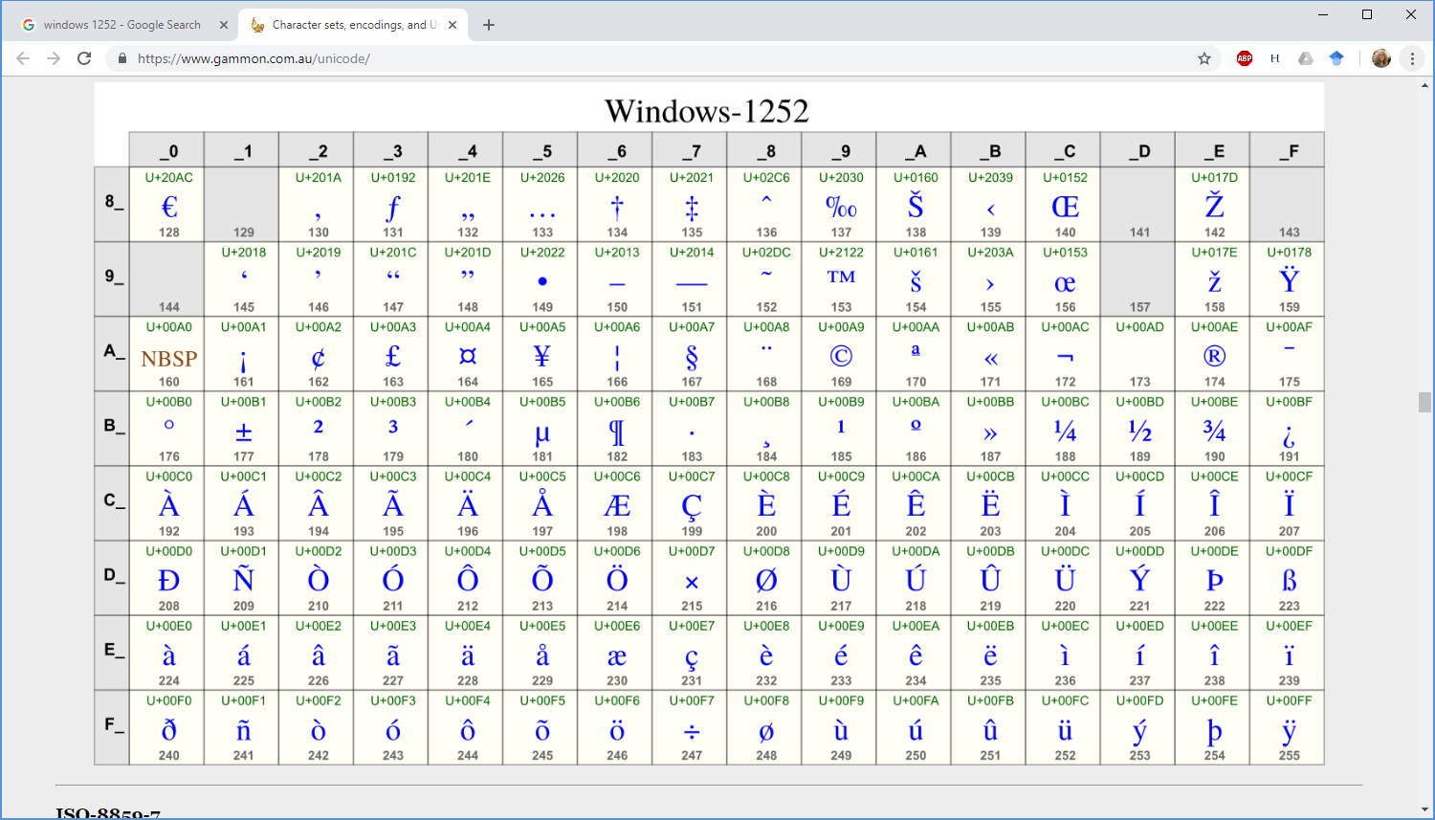
Source: https://www.gammon.com.au/unicode/

Slide 18
code pages
But this meant that it was difficult to share files between users in different countries.
They didn’t even have those foreign characters!

Slide 19

Unicode
In the late 1980s, Unicode (Universal Coded Character Set) was invented.
Used 16-bit characters = 65,536 code points, thought at the time to be more than anyone could ever need.
Characters were still always the same size.
Formalized as UTF-16 encoding.

Slide 20
UTF-16
Microsoft adopted UTF-16 for their core Windows API as their “wide characters.”
macOS, IBM I, Java, JavaScript, .NET, Python, and even SMS text messaging also adopted this encoding.

Slide 21
UTF-16
Required a Byte Order Mark (BOM) at the start of a file to indicate if it was “big-endian” (high byte first) or “little- endian” (low byte first).
ff fe Little-endian UTF-16
fe ff Big-endian UTF-16
If you saw the BOM you expected, it meant you were reading it correctly.

Slide 22
UTF-16
Did not get wider use because it was incompatible with ASCII, and seen wasteful, requiring two bytes for every character at a time when most PCs only had 640K.

Slide 23
UTF-16
A bigger problem was what to do if you needed more than 64K code points.
Unicode now defines over a 1M code points, including almost 4,000 emojis.

Slide 24
UTF-16
The solution was to introduce “surrogates”.
Values greater than 0xffff were broken into two 16-bit characters holding 10 bits each.
Notorious for causing bugs in programs that didn’t anticipate that characters could be variable length.

Slide 25
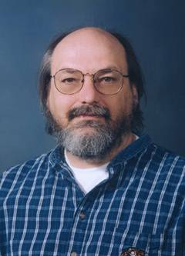
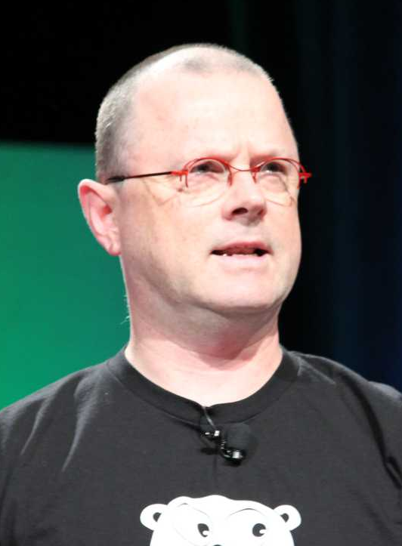
UTF-8
Invented in 1992 by Ken Thompson and Rob Pike, sketched out on a dinner placemat over a meal in a NJ diner.
Image sources: https://en.wikipedia.org/wiki/Ken_Thompson
https://en.wikipedia.org/wiki/Rob_Pike

Slide 26
UTF-8
Backward compatible with 7-bit ASCII.
Characters > 0x7F require more bytes.
The larger the character value, the more bytes.
Each additional byte gives you an additional 5 bits. Some sequences are invalid.
Capable of encoding 31 bits.
BOMs are allowed but not needed and discouraged.

Slide 27
UTF-8 sequences
Valid UTF-8 sequences
U-00000000 - U-0000007F: 0xxxxxxx 7 bits
U-00000080 - U-000007FF: 110xxxxx 10xxxxxx 11 bits
U-00000800 - U-0000FFFF: 1110xxxx 10xxxxxx 10xxxxxx 16 bits
U-00010000 - U-001FFFFF: 11110xxx 10xxxxxx 10xxxxxx 10xxxxxx 21 bits
U-00200000 - U-03FFFFFF: 111110xx 10xxxxxx 10xxxxxx 10xxxxxx 10xxxxxx 26 bits
U-04000000 - U-7FFFFFFF: 1111110x 10xxxxxx 10xxxxxx 10xxxxxx 10xxxxxx 10xxxxxx 31 bits
Invalid, Overlong UTF-8 Sequences which should never be accepted because of the security risk and are replaced with 0xfffd:
11 bits to encode 7 1100000x 10xxxxxx
16 bits to encode 11 11100000 100xxxxx 10xxxxxx
21 bits to encode 16 11110000 1000xxxx 10xxxxxx 10xxxxxx
26 bits to encode 21 11111000 10000xxx 10xxxxxx 10xxxxxx 10xxxxxx
31 bits to encode 26 11111100 100000xx 10xxxxxx 10xxxxxx 10xxxxxx 10xxxxxx

Slide 28
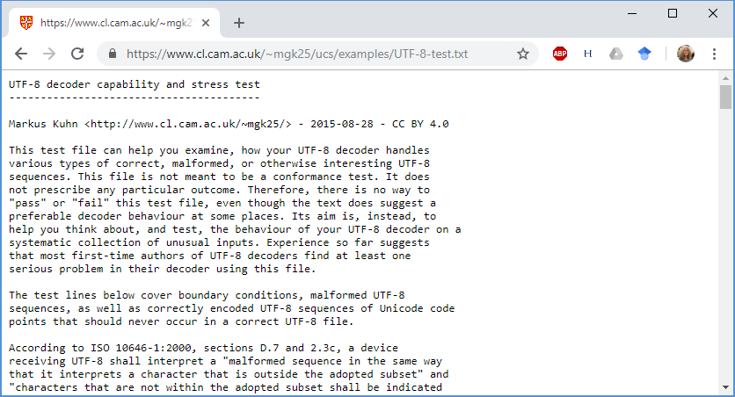
Utf8 test case
UTF-8 decoder capability and stress test
http://www.cl.cam.ac.uk/~mgk25/ucs/examples/UTF-8-test.txt

Slide 29
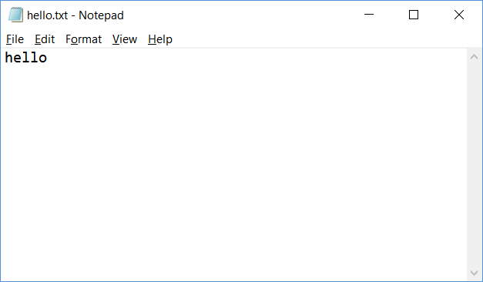
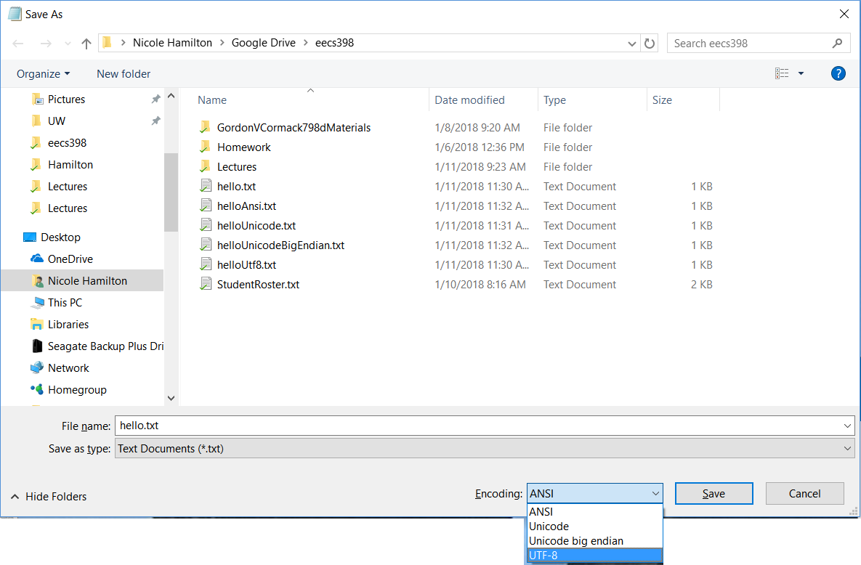

Slide 30
256 C% ls hello*.txt
hello.txt helloUnicode.txt helloUtf8.txt
helloAnsi.txt helloUnicodeBigEndian.txt
257 C% xd hello.txt
00000000: 6865 6c6c 6f0d 0a *hello..*
258 C% xd helloAnsi.txt
00000000: 6865 6c6c 6f0d 0a *hello..*
259 C% cmp hello.txt helloAnsi.txt
260 C% xd helloUtf8.txt
00000000: efbb bf68 656c 6c6f 0d0a *...hello ..*
261 C% xd helloUnicode.txt
00000000: fffe 6800 6500 6c00 6c00 6f00 0d00 0a00 *..h.e.l. l.o.....*
262 C% xd helloUnicodeBigEndian.txt
00000000: feff 0068 0065 006c 006c 006f 000d 000a *...h.e.l .l.o....*
263 C%

Slide 31
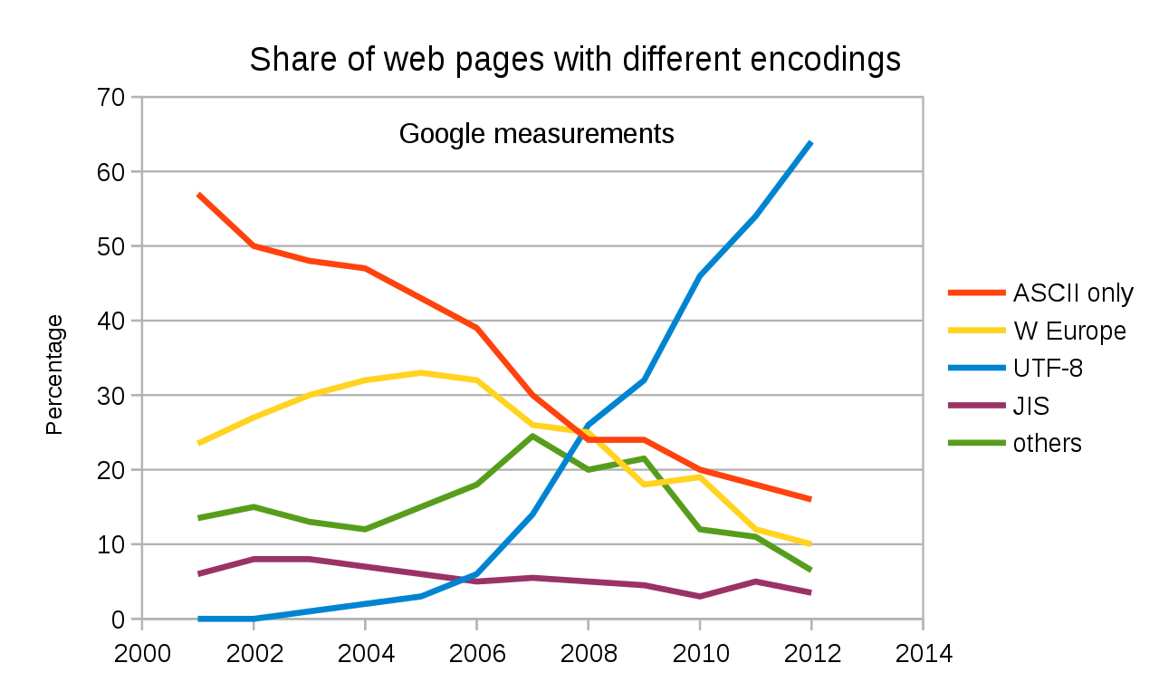
Image source: https://en.wikipedia.org/wiki/UTF-8

Slide 32
today
UTF-8 is overwhelmingly dominant on the web, used by nearly 99% of websites as of early 2026, making it the standard for the internet, default for HTML5, and crucial for displaying diverse languages, emojis, and symbols globally.

Slide 33
your homework
#include <cstddef>
#include <cstdint>
typedef uint32_t Utf32;
typedef uint16_t Unicode;
typedef uint8_t Utf8;
// SizeOfUtf8 tells the number of bytes it will take to encode the
// specified Unicode value.
int SizeOfUtf8( Unicode c );
// Get the UTF-8 character as a Unicode value.
// If it's an invalid UTF-8 encoding for a U-16
// character, return the special malformed
// character code.
Unicode GetUtf8( Utf8 *p );
// NextUtf8 will scan forward to the next byte
// which could be the start of a UTF-8 character.
// If it's on a null character, it scans over it.
Utf8 *NextUtf8( Utf8 *p );

Slide 34
// Scan backward for the first PREVIOUS byte which could
// be the start of a UTF-8 character.
Utf8 *PreviousUtf8( Utf8 *p );
// Write a Unicode character in UTF-8.
Utf8 *WriteUtf8( Utf8 *p, Unicode c );

Slide 35
Agenda
Course details.
HTML.
Unicode and Utf8.
HTTP.
Redirects.

Slide 36
the basic parts of a search engine
HTML parser.
Crawler.
Index.
Constraint solver.
Query language.
Ranker.
Front end.

Slide 37
initial focus
HTML parser.
Crawler.
Index.
Constraint solver.
Query language.
Ranker.
Front end.
Task: Extract the content from a HTML file as:
A series of tokens in the contents and
A set of links with anchor text to other documents.

Slide 38
initial focus
HTML parser.
Crawler.
Index.
Constraint solver.
Query language.
Ranker.
Front end.
Depend on understanding how a browser talks to a webpage.

Slide 39
initial focus
HTML parser.
Crawler.
Index.
Constraint solver.
Query language.
Ranker.
Front end.
Topics:
HTML as a markup language for the contents of a webpage.
Basic HTTP handshake and redirects.

Slide 40
initial focus
Need to serialize and deserialize data.
Lossy or lossless.
Human-readable or binary.
Stateless or stateful.

Slide 41
initial focus
Need to serialize and deserialize data.
Lossy or lossless.
Human-readable or binary.
Stateless or stateful.
Examples:
.zip: Lossless, binary, stateless.
.jpg: Lossy, binary, stateless.
.html: Lossless, text, possibly stateful, e.g., login, shopping carts.

Slide 42
initial focus
Need to serialize and deserialize data.
Lossy or lossless.
Human-readable or binary.
Stateless or stateful.
Question of where to store state.
Examples:
.zip: Lossless, binary, stateless.
.jpg: Lossy, binary, stateless.
.html: Lossless, text, possibly stateful, e.g., login, shopping carts.

Slide 43
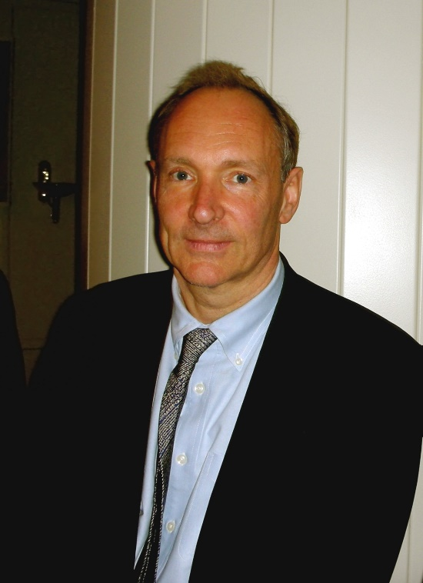
the webpage concept
Invented by Tim Berners-Lee as a way to serialize the text on the page along with formatting information, include images and hyperlinks to other pages.
Human-readable because it was written by hand.
Tim Berners-Lee
Image source: https://en.wikipedia.org/wiki/File:Tim_Berners-Lee_April_2009.jpg

Slide 44
the World Wide Web is born
1980 Tim Berners-Lee, a contractor at CERN, creates a prototype system to share documents.
1989 He invents HTML and wrote a browser and a server.
1991 First publicly available HTML specification. Defines only 18 elements. (There are now 139.)
Tim Berners-Lee
Image source: https://en.wikipedia.org/wiki/File:Tim_Berners-Lee_April_2009.jpg

Slide 45
XML
The web is linked through text files with hyperlinks.
The basic idea is similar to XML (Extensible Markup Language), intended as a way to allow human-readable text serialization of complex objects.
<myThing myProperties="...">
anything I want
</myThing>

Slide 46
XML
The web is linked through text files with hyperlinks.
The basic idea is similar to XML (Extensible Markup Language), intended as a way to allow human-readable text serialization of complex objects.
<myThing myProperties="...">
anything I want
</myThing>
It's recursive. This can be another XML structure.

Slide 47
XML
If the object doesn’t enclose anything, it can be written in a short form.
<myLeafThing myProperties="..."/>

Slide 48
HTML
Hypertext Markup Language.
Loosely follows XML conventions.
Grown somewhat organically as the web grew in the 90s and browsers began offering their own features.
There are standards but not everyone cares.
Closing tags and both opening and closing quotes are notoriously absent a lot of the time.

Slide 49
a typical HTML page
<!DOCTYPE html PUBLIC "-//W3C//DTD XHTML 1.0 Strict//EN"
"http://www.w3.org/TR/xhtml1/DTD/xhtml1-strict.dtd">
<html xmlns="http://www.w3.org/1999/xhtml">
<head>
<meta content="text/html; charset=utf-8" http-equiv="Content-Type" />
<title>Page title shown in the browser tab</title>
<script>Lots of gibberish</script>
<link href="MyStyles.css" rel="stylesheet" type="text/css" />
<link href="https://mydomain/favicon.ico" rel="shortcut icon" />
<meta name="DC.Rights" content="Copyright 2018 my name"/>
<meta name="description" content=“Short abstract."/>
<meta name="keywords" content=“arbitrary list of words"/>
</head>
<body>
:
</body>
</html>

Slide 50
a typical HTML page
<!DOCTYPE html PUBLIC "-//W3C//DTD XHTML 1.0 Strict//EN"
"http://www.w3.org/TR/xhtml1/DTD/xhtml1-strict.dtd">
<html xmlns="http://www.w3.org/1999/xhtml">
<head>
<meta content="text/html; charset=utf-8" http-equiv="Content-Type" />
<title>Page title shown in the browser tab</title>
<script>Lots of gibberish</script>
<link href="MyStyles.css" rel="stylesheet" type="text/css" />
<link href="https://mydomain/favicon.ico" rel="shortcut icon" />
<meta name="DC.Rights" content="Copyright 2018 my name"/>
<meta name="description" content=“Short abstract."/>
<meta name="keywords" content=“arbitrary list of words"/>
</head>
<body>
:
</body>
</html>
The !DOCTYPE and html tags describe the standards the page ostensibly conforms to. (Generally useless.)

Slide 51
a typical HTML page
<!DOCTYPE html PUBLIC "-//W3C//DTD XHTML 1.0 Strict//EN"
"http://www.w3.org/TR/xhtml1/DTD/xhtml1-strict.dtd">
<html xmlns="http://www.w3.org/1999/xhtml">
<head>
<meta content="text/html; charset=utf-8" http-equiv="Content-Type" />
<title>Page title shown in the browser tab</title>
<script>Lots of gibberish</script>
<link href="MyStyles.css" rel="stylesheet" type="text/css" />
<link href="https://mydomain/favicon.ico" rel="shortcut icon" />
<meta name="DC.Rights" content="Copyright 2018 my name"/>
<meta name="description" content=“Short abstract."/>
<meta name="keywords" content=“arbitrary list of words"/>
</head>
<body>
:
</body>
</html>
The meta tag describes the content, character set, and other attributes. (Google list.)

Slide 52
a typical HTML page
<!DOCTYPE html PUBLIC "-//W3C//DTD XHTML 1.0 Strict//EN"
"http://www.w3.org/TR/xhtml1/DTD/xhtml1-strict.dtd">
<html xmlns="http://www.w3.org/1999/xhtml">
<head>
<meta content="text/html; charset=utf-8" http-equiv="Content-Type" />
<title>Page title shown in the browser tab</title>
<script>Lots of gibberish</script>
<link href="MyStyles.css" rel="stylesheet" type="text/css" />
<link href="https://mydomain/favicon.ico" rel="shortcut icon" />
<meta name="DC.Rights" content="Copyright 2018 my name"/>
<meta name="description" content=“Short abstract."/>
<meta name="keywords" content=“arbitrary list of words"/>
</head>
<body>
:
</body>
</html>
The page title is highly relevant.

Slide 53
a typical HTML page
<!DOCTYPE html PUBLIC "-//W3C//DTD XHTML 1.0 Strict//EN"
"http://www.w3.org/TR/xhtml1/DTD/xhtml1-strict.dtd">
<html xmlns="http://www.w3.org/1999/xhtml">
<head>
<meta content="text/html; charset=utf-8" http-equiv="Content-Type" />
<title>Page title shown in the browser tab</title>
<script>Lots of gibberish</script>
<link href="MyStyles.css" rel="stylesheet" type="text/css" />
<link href="https://mydomain/favicon.ico" rel="shortcut icon" />
<meta name="DC.Rights" content="Copyright 2018 my name"/>
<meta name="description" content=“Short abstract."/>
<meta name="keywords" content=“arbitrary list of words"/>
</head>
<body>
:
</body>
</html>
Scripts are literally gibberish unless you execute them. Google and other engines probably do run scripts on some sites.

Slide 54
a typical HTML page
<!DOCTYPE html PUBLIC "-//W3C//DTD XHTML 1.0 Strict//EN"
"http://www.w3.org/TR/xhtml1/DTD/xhtml1-strict.dtd">
<html xmlns="http://www.w3.org/1999/xhtml">
<head>
<meta content="text/html; charset=utf-8" http-equiv="Content-Type" />
<title>Page title shown in the browser tab</title>
<script>Lots of gibberish</script>
<link href="MyStyles.css" rel="stylesheet" type="text/css" />
<link href="https://mydomain/favicon.ico" rel="shortcut icon" />
<meta name="DC.Rights" content="Copyright 2018 my name"/>
<meta name="description" content=“Short abstract."/>
<meta name="keywords" content=“arbitrary list of words"/>
</head>
<body>
:
</body>
</html>
The stylesheet contains CSS formatting information which we don’t really care about.

Slide 55
a typical HTML page
<!DOCTYPE html PUBLIC "-//W3C//DTD XHTML 1.0 Strict//EN"
"http://www.w3.org/TR/xhtml1/DTD/xhtml1-strict.dtd">
<html xmlns="http://www.w3.org/1999/xhtml">
<head>
<meta content="text/html; charset=utf-8" http-equiv="Content-Type" />
<title>Page title shown in the browser tab</title>
<script>Lots of gibberish</script>
<link href="MyStyles.css" rel="stylesheet" type="text/css" />
<link href="https://mydomain/favicon.ico" rel="shortcut icon" />
<meta name="DC.Rights" content="Copyright 2018 my name"/>
<meta name="description" content=“Short abstract."/>
<meta name="keywords" content=“arbitrary list of words"/>
</head>
<body>
:
</body>
</html>
The stylesheet contains CSS formatting information (which we don’t really care about.)

Slide 56
CSS
html,body {
height: 100%;
background-color: #f2f2f7;
color: black;
font-family: Verdana, Arial, Helvetica, sans-serif;
font-size: 0.9em;
}
p {
line-height: 17px;
margin-top:14px;
margin-bottom:17px;
}
h1,h2,h3,h4,h5,h6 {
color: #3d6c87;
}
a {
color: #5f8ea9;
text-decoration: none;
}
a:hover {
color: #33627d;
}
The CSS describes fonts, colors, etc., to be used when drawing various HTML elements but it doesn’t change the words on the page, only how they appear.

Slide 57
a typical HTML page
<!DOCTYPE html PUBLIC "-//W3C//DTD XHTML 1.0 Strict//EN"
"http://www.w3.org/TR/xhtml1/DTD/xhtml1-strict.dtd">
<html xmlns="http://www.w3.org/1999/xhtml">
<head>
<meta content="text/html; charset=utf-8" http-equiv="Content-Type" />
<title>Page title shown in the browser tab</title>
<script>Lots of gibberish</script>
<link href="MyStyles.css" rel="stylesheet" type="text/css" />
<link href="https://mydomain/favicon.ico" rel="shortcut icon" />
<meta name="DC.Rights" content="Copyright 2018 my name"/>
<meta name="description" content=“Short abstract."/>
<meta name="keywords" content=“arbitrary list of words"/>
</head>
<body>
:
</body>
</html>
Description may be useful since search engines often display it in search results.

Slide 58
a typical HTML page
<!DOCTYPE html PUBLIC "-//W3C//DTD XHTML 1.0 Strict//EN"
"http://www.w3.org/TR/xhtml1/DTD/xhtml1-strict.dtd">
<html xmlns="http://www.w3.org/1999/xhtml">
<head>
<meta content="text/html; charset=utf-8" http-equiv="Content-Type" />
<title>Page title shown in the browser tab</title>
<script>Lots of gibberish</script>
<link href="MyStyles.css" rel="stylesheet" type="text/css" />
<link href="https://mydomain/favicon.ico" rel="shortcut icon" />
<meta name="DC.Rights" content="Copyright 2018 my name"/>
<meta name="description" content=“Short abstract."/>
<meta name="keywords" content=“arbitrary list of words"/>
</head>
<body>
:
</body>
</html>
Not displayed in a browser window. Easily spammed. Probably not useful.

Slide 59
a typical HTML page
<!DOCTYPE html PUBLIC "-//W3C//DTD XHTML 1.0 Strict//EN"
"http://www.w3.org/TR/xhtml1/DTD/xhtml1-strict.dtd">
<html xmlns="http://www.w3.org/1999/xhtml">
<head>
<meta content="text/html; charset=utf-8" http-equiv="Content-Type" />
<title>Page title shown in the browser tab</title>
<script>Lots of gibberish</script>
<link href="MyStyles.css" rel="stylesheet" type="text/css" />
<link href="https://mydomain/favicon.ico" rel="shortcut icon" />
<meta name="DC.Rights" content="Copyright 2018 my name"/>
<meta name="description" content=“Short abstract."/>
<meta name="keywords" content=“arbitrary list of words"/>
</head>
<body>
:
</body>
</html>
The body text of the page.

Slide 60
<body> and <div>
<body>
<div id="masthead" style="padding-top: 20px; padding-left:74px">
:
</div>
<div id="content">
:
</div>
<div id="sidebar">
:
</div>
</body>
The <body> contains the actual content of the page.
<div> … </div> sections can be used to create separate panels on the page, applying different CSS styles.

Slide 61
<a>
<div id="content">
<a href="clickURL1">
<img src="myimage.jpg" .../>
</a>
<p>
Plain text<br/>
Link to <a href=“https://www.nytimes.com">The New York Times</a>
</p>
</div>
Hyperlinks are marked with <a> tags. The text between the opening <a> and closing </a> tags are the anchor text and are very relevant for ranking.

Slide 62
<img>, <h1>, and <p>
Images are added with <img> tags.
<div id="content">
<img src="mypath.png" alt="..." width="..."/>
<h1 style="...">This is a big heading</h1>
<p>
:
</p>
<h3 style="...">This is a smaller heading</h3>
<p>
:
</p>
<p>
:
</p>
</div>
Heading use <h1>, <h2>, etc., tags.
Paragraphs are marked with <p> tags. The closing </p> are often missing.

Slide 63
&-escapes
<div id="content">
<p>
if ( b<a ) ...
</p>
</div>
<div id="content">
<p>
if ( b&lt;a ) ...
</p>
</div>
Special characters are written using &-escapes.

Slide 64
Agenda
Course details.
HTML.
Unicode and Utf8.
HTTP.
Redirects.

Slide 65
HTML parser
Extract the content from a HTML file as a series of tokens in the title and the body of the document and a set of links with anchor text to other documents.
Up to you to decide:
What information should you collect?
How will you deal with malformed content?
How should the information you collect be represented as an object?

Slide 66
URLs
Basic format protocol:path
Common protocols http:
https:
ftp:
mailto:
file:
The path may be relative to the directory of the referring page or it may start at a root of the website.
http: and https: are the protocols for reading web pages.
We will do this by opening sockets to these URLs in C++ but for now, you can use tools like curl to experiment.

Slide 67
HTTP and HTTPS
These are protocols for exchanging content between a server and a browser.
It’s a human-readable format of requests and responses.
The difference between HTTP and HTTPS is whether it’s conducted over a secure socket layer (SSL) with encryption.

Slide 68
HTTP and HTTPS
It’s a simple handshake for exchanging data.
Browser sends GET or other method + a path and a protocol.
Server returns an OK + the requested content.
Any number of additional headers in any order.
Every line terminated with \r\n.
End of the header marked by a blank line, followed by the content.

Slide 69
Browser requests a page with a GET.
GET / HTTP/1.1
Host: www.nytimes.com
User-Agent: LinuxGetSsl/2.0 nham@umich.edu (Linux)
Accept: */*
Accept-Encoding: identity
Connection: close
HTTP/1.1 200 OK
Connection: close
Content-Length: 1150280
Server: nginx
Content-Type: text/html; charset=utf-8
x-nyt-data-last-modified: Mon, 01 Feb 2021 15:59:19 GMT
Last-Modified: Mon, 01 Feb 2021 15:59:19 GMT
:
<!DOCTYPE html>
<html lang="en-US" xmlns:og="http://opengraphprotocol.org/schema/">
:
Server responds with an HTTP 200 OK message, a bunch of optional HTTP headers, a blank line and then the content.

Slide 70
As seen with the server you’ll build, the browser requests a page.
tcsh-29% sudo ./LinuxTinyServer 5000 '/mnt/c/Users/hamil/Google Drive/UMich Faculty Page/'
Listening on 0.0.0.0:5000
Connection accepted from 127.0.0.1:54588
Connection accepted from 127.0.0.1:54589
GET /index.htm HTTP/1.1
Host: localhost:5000
Connection: keep-alive
Cache-Control: max-age=0
Upgrade-Insecure-Requests: 1
User-Agent: Mozilla/5.0 (Windows NT 10.0; Win64; x64) AppleWebKit/537.36 (KHTML, like Gecko) Chrome/76.0.3809.132 Safari/537.36
Sec-Fetch-Mode: navigate
Sec-Fetch-User: ?1
Accept: text/html,application/xhtml+xml,application/xml;q=0.9,image/webp,image/apng,*/*;q=0.8,application/signed-exchange;v=b3
Sec-Fetch-Site: none
Accept-Encoding: gzip, deflate, br
Accept-Language: en-US,en;q=0.9

Slide 71
This happens to be a request from a Chrome browser. Notice the user agent.
tcsh-29% sudo ./LinuxTinyServer 5000 '/mnt/c/Users/hamil/Google Drive/UMich Faculty Page/'
Listening on 0.0.0.0:5000
Connection accepted from 127.0.0.1:54588
Connection accepted from 127.0.0.1:54589
GET /index.htm HTTP/1.1
Host: localhost:5000
Connection: keep-alive
Cache-Control: max-age=0
Upgrade-Insecure-Requests: 1
User-Agent: Mozilla/5.0 (Windows NT 10.0; Win64; x64) AppleWebKit/537.36 (KHTML, like Gecko) Chrome/76.0.3809.132 Safari/537.36
Sec-Fetch-Mode: navigate
Sec-Fetch-User: ?1
Accept: text/html,application/xhtml+xml,application/xml;q=0.9,image/webp,image/apng,*/*;q=0.8,application/signed-exchange;v=b3
Sec-Fetch-Site: none
Accept-Encoding: gzip, deflate, br
Accept-Language: en-US,en;q=0.9

Slide 72
In your own requests, identify yourself for complaints. Here’s an example:
Connection accepted from 127.0.0.1:54659
GET /index.htm HTTP/1.1
Host: localhost
User-Agent: LinuxGetUrl/2.0 nham@umich.edu (Linux)
Accept: */*
Accept-Encoding: identity
Connection: close

Slide 73
The server maps the requested /index.htm to the actual file and responds.
HTTP/1.1 200 OK
Content-Length: 8964
Connection: close
Content-Type: text/html
<!DOCTYPE html PUBLIC "-//W3C//DTD XHTML 1.0 Strict//EN"
"http://www.w3.org/TR/xhtml1/DTD/xhtml1-strict.dtd">
<html xmlns="http://www.w3.org/1999/xhtml">
<head>
<meta content="text/html; charset=utf-8" http-equiv="Content-Type" />
<title>Nicole Hamilton</title>
<link href="Styles/Hamilton.css" rel="stylesheet" type="text/css" />
:
:

Slide 74
Errors are reported as 400 and other codes. (You’ll build your own LinuxGetUrl.)
tcsh-2% ./LinuxGetUrl http://localhost:5000/zork.htm
Service = http, Host = localhost, Port = 5000, Path = zork.htm
Host address length = 16 bytes
Family = 2, port = 5000, address = 127.0.0.1
GET /zork.htm HTTP/1.1
Host: localhost
User-Agent: LinuxGetUrl/2.0 nham@umich.edu (Linux)
Accept: */*
Accept-Encoding: identity
Connection: close
HTTP/1.1 404 Not Found
Content-Length: 0
Connection: close
tcsh-3%

Slide 75
Agenda
Course details.
HTML.
Unicode and Utf8.
HTTP.
Redirects.

Slide 76
Often, you’ll encounter redirects, e.g., from HTTP to HTTPS.
tcsh-8% ./LinuxGetUrl http://en.wikipedia.org
:
GET / HTTP/1.1
:
HTTP/1.1 301 TLS Redirect
Date: Thu, 12 Sep 2019 17:17:56 GMT
Server: Varnish
X-Varnish: 316194658
X-Cache: cp1087 int
X-Cache-Status: int-front
Server-Timing: cache;desc="int-front"
Set-Cookie: WMF-Last-Access=12-Sep-2019;Path=/;HttpOnly;secure;Expires=Mon, 14 Oct 2019 12:00:00 GMT
Set-Cookie: WMF-Last-Access-Global=12-Sep-2019;Path=/;Domain=.wikipedia.org;HttpOnly;secure;Expires=Mon, 14 Oct 2019 12:00:00 GMThttps://en.wikipedia.org/
X-Client-IP: 68.51.181.4
Location: https://en.wikipedia.org/
Content-Length: 0
Connection: close
tcsh-9%

Slide 77
One redirect may lead to another. (You’ll build your own LinuxGetSsl as well.)
tcsh-10% ./LinuxGetSsl https://en.wikipedia.org/
:
HTTP/1.1 301 Moved Permanently
Date: Thu, 12 Sep 2019 17:23:22 GMT
Content-Type: text/html; charset=utf-8
Content-Length: 0
Connection: close
Server: mw1268.eqiad.wmnet
X-Powered-By: HHVM/3.18.6-dev
P3P: CP="See https://en.wikipedia.org/wiki/Special:CentralAutoLogin/P3P for more info."
Cache-control: s-maxage=1200, must-revalidate, max-age=0
X-Content-Type-Options: nosniff
Location: https://en.wikipedia.org/wiki/Main_Page
Last-Modified: Thu, 12 Sep 2019 17:14:50 GMT
:
tcsh-11%

